Slide 1
Module 2
Location and Handoff Management

Slide 2
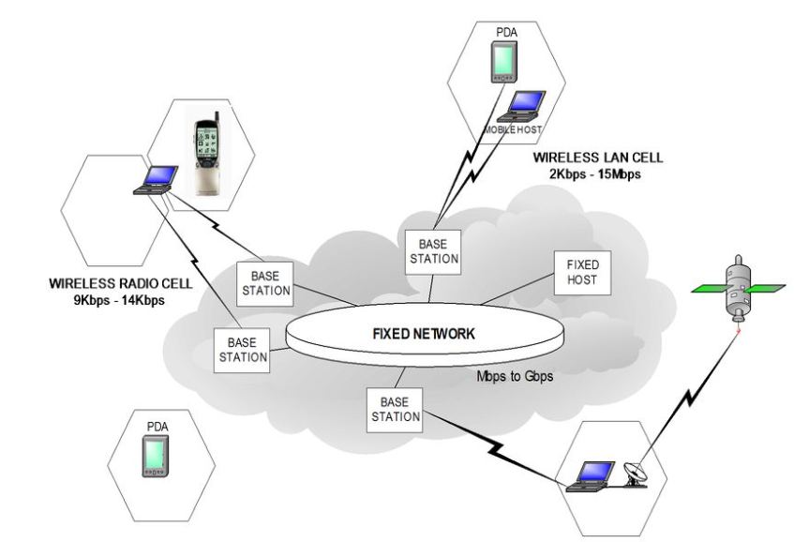
Mobile Network Architecture

Slide 3
GSM
formerly: Groupe Spéciale Mobile (founded 1982)
now: Global System for Mobile Communication
Pan-European standard (ETSI, European Telecommunications Standardisation Institute)
many providers all over the world use GSM (more than 130 countries in Asia, Africa, Europe, Australia, America)
more than 100 million subscribers

Slide 4
Performance characteristics of GSM
Communication
mobile, wireless digital communication; support for voice and data services
Total mobility
international access, chip-card enables use of access points of different providers
Worldwide connectivity
one number, the network handles localization High capacity
better frequency efficiency, smaller cells, more customers per cell
High transmission quality
high audio quality
uninterrupted phone calls at higher speeds (e.g., from cars, trains) – better handoffs and
Security functions
access control, authentication via chip-card and PIN

Slide 5
GSM: Mobile Services
GSM offers
several types of connections
voice connections, data connections, short message service
Three service domains
Bearer Services – interface to the physical medium (transparent for example in the case of voice or nontransparent for data services)
Telematic Services – services provided by the system to the end user (e.g., voice, SMS, fax, etc.)
Supplementary Services – associated with the tele services: call forwarding, redirection, etc.
bearer services
MS
GSM-PLMN
transit
network
(PSTN, ISDN)
source/
destination
network
TE
MT
TE
R, S
U_{m}
(U, S, R)
tele services

Slide 6
Architecture of the GSM system
GSM is a PLMN (Public Land Mobile Network)
several providers setup mobile networks following the GSM standard within each country
components
MS (mobile station)
BS (base station)
MSC (mobile switching center)
LR (location register)
subsystems
RSS (radio subsystem): covers all radio aspects
NSS (network and switching subsystem): call forwarding, handover, switching
OSS (operation subsystem): management of the network

Slide 7
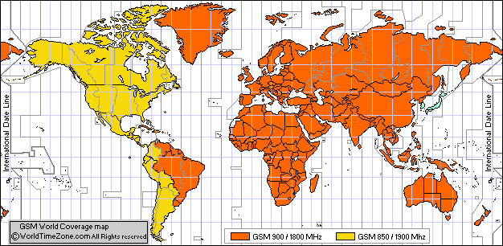
GSM World Coverage Map
https://www.worldtimezone.com/gsm.html

Slide 8
India | 900 | 1800 | 3G 900/2100 AirTel; 3G 2100 BSNL; 3G 2100 MTNL; 3G 2100 Tata Docomo; 3G 2100 Vodafone Idea LTD ; | 4G LTE Vodafone Idea LTD 1800/2100/2500Mhz ; 4G LTE Bharti Airtel 1800/2100/2300Mhz; 4G LTE Jio 850/1800/2300mhz; 4G LTE BSNL 2500Mhz (trial); 4G LTE Tata DoCoMo Teleservices 900/1800/2100/2300Mhz ;

Slide 9
GSM: elements and interfaces
radio cell
MS
MS
BSS
U_{m}
radio cell
RSS
BTS
MS
BTS
A_{bis}
BSC
BSC
A
MSC
MSC
NSS
VLR
VLR
signaling
HLR
GMSC
ISDN, PSTN
IWF
PDN
O
OSS
EIR
AUC
OMC

Slide 10
GSM: overview
OMC, EIR, AUC
HLR
fixed network
GMSC
NSS
with OSS
VLR
MSC
VLR
MSC
BSC
BSC
RSS

Slide 11
GSM: System Architecture
radio subsystem
network and switching subsystem
fixed partner networks
MS
MS
ISDN PSTN
U_{m}
MSC
BTS
A_{bis}
BSC
EIR
BTS
SS7
HLR
BTS
VLR
BSC
ISDN PSTN
BTS
A
MSC
BSS
IWF
PSPDN CSPDN

Slide 12
System architecture: radio subsystem
radio subsystem
network and switching subsystem
MS
MS
Components
MS (Mobile Station)
BSS (Base Station Subsystem): consisting of
BTS (Base Transceiver Station): sender and receiver
BSC (Base Station Controller): controlling several transceivers
Interfaces
U_{m} : radio interface
A_{bis} : standardized, open interface with 16 kbit/s user channels
A: standardized, open interface with 64 kbit/s user channels
U_{m}
BTS
A_{bis}
BSC
MSC
BTS
A
BTS
MSC
BSC
BTS
BSS

Slide 13
Radio subsystem
The Radio Subsystem (RSS) comprises the cellular mobile network up to the switching centers
Components
Base Station Subsystem (BSS):
Base Transceiver Station (BTS): radio components including sender, receiver, antenna - if directed antennas are used one BTS can cover several cells
Base Station Controller (BSC): switching between BTSs, controlling BTSs, managing of network resources, mapping of radio channels (U_{m}) onto terrestrial channels (A interface)
BSS = BSC + sum(BTS) + interconnection
Mobile Stations (MS)

Slide 14
Mobile station
Terminal for the use of GSM services
A mobile station (MS) comprises several functional groups
MT (Mobile Terminal):
offers common functions used by all services the MS offers
corresponds to the network termination (NT) of an ISDN access
end-point of the radio interface (U_{m})
TA (Terminal Adapter):
terminal adaptation, hides radio specific characteristics (TE connects via modem, Bluetooth, IrDA etc. to MT)
TE (Terminal Equipment):
peripheral device of the MS, offers services to a user
Can be a headset, microphone, etc.
does not contain GSM specific functions
SIM (Subscriber Identity Module):
personalization of the mobile terminal, stores user parameters
TE
TA
MT
R
S
U_{m}

Slide 15
System architecture: network and switching subsystem
network subsystem
fixed partner networks
Components
MSC (Mobile Services Switching Center):
IWF (Interworking Functions)
ISDN (Integrated Services Digital Network)
PSTN (Public Switched Telephone Network)
PSPDN (Packet Switched Public Data Net.)
CSPDN (Circuit Switched Public Data Net.)
Databases
HLR (Home Location Register)
VLR (Visitor Location Register)
EIR (Equipment Identity Register)
ISDN PSTN
MSC
EIR
SS7
HLR
VLR
ISDN PSTN
MSC
IWF
PSPDN CSPDN

Slide 16
Network and switching subsystem
NSS is the main component of the public mobile network GSM
switching, mobility management, interconnection to other networks, system control
Components
Mobile Services Switching Center (MSC) controls all connections via a separated network to/from a mobile terminal within the domain of the MSC - several BSC can belong to a MSC
Databases (important: scalability, high capacity, low delay)
Home Location Register (HLR) central master database containing user data, permanent and semi-permanent data of all subscribers assigned to the HLR (one provider can have several HLRs)
Visitor Location Register (VLR) local database for a subset of user data - data about all users currently visiting in the domain of the VLR

Slide 17
Mobile Services Switching Center
The MSC (mobile switching center) plays a central role in GSM
switching functions
additional functions for mobility support
management of network resources
interworking functions via Gateway MSC (GMSC)
integration of several databases
Functions of a MSC
specific functions for paging and call forwarding
termination of SS7 (signaling system no. 7)
mobility specific signaling
location registration and forwarding of location information
provision of new services (fax, data calls)
support of short message service (SMS)
generation and forwarding of accounting and billing information

Slide 18
Operation subsystem
The OSS (Operation Subsystem) enables centralized operation, management, and maintenance of all GSM subsystems
Components
Authentication Center (AUC)
generates user specific authentication parameters on request of a VLR
authentication parameters used for authentication of mobile terminals and encryption of user data on the air interface within the GSM system
Equipment Identity Register (EIR)
registers GSM mobile stations and user rights
stolen or malfunctioning mobile stations can be locked and sometimes even localized
Operation and Maintenance Center (OMC)
different control capabilities for the radio subsystem and the network subsystem

Slide 19
GSM protocol layers for signaling
U_{m}
A_{bis}
A
MS
BTS
BSC
MSC
CM
CM
MM
MM
RR
RR’
BTSM
BSSAP
BSSAP
RR’
BTSM
SS7
SS7
LAPD_{m}
LAPD_{m}
LAPD
LAPD
radio
radio
PCM
PCM
PCM
PCM
16/64 kbit/s
64 kbit/s /
2.048 Mbit/s

Slide 20
Layer 1, the physical layer
handles all radio-specific functions
-includes the creation of bursts according to the five different formats,
multiplexing of bursts into a TDMA frame, synchronization with the BTS,
detection of idle channels, and measurement of the channel quality on the downlink.
The physical layer at Um uses GMSK for digital modulation and performs encryption/decryption of data, encryption is between MS and BSS over the air interface.
The main tasks of the physical layer comprise
channel coding and error detection/correction, which is directly combined with the coding mechanisms.
Channel coding uses forward error correction (FEC) schemes.
The physical layer also contains special functions, such as voice activity detection (VAD), which transmits voice data only when there is a voice signal
During periods of silence the physical layer generates a comfort noise to fake a connection
but no actual transmission takes place.

Slide 21
Layer 2, LAPDm
The LAPDm protocol has been defined at the Um interface .
LAPDm, link access procedure for the D-channel (LAPD) in ISDN systems, . LAPDm is a lightweight LAPD
LAPDm offers reliable data transfer over connections, re-sequencing of data frames, and flow control
LAPDm has to obey the frame structures recurrence patterns etc. defined for the Um interface as there is no buffering between layer one and two,
LAPDm provides segmentation and reassembly of data and acknowledged/unacknowledged data transfer.

Slide 22
layer 3,network layer
Comprises several sublayers as
Radio resource management (RR).
Only a part of this layer, RR’, is implemented in the BTS, the remainder is situated in the BSC.
The functions of RR’ are supported by the BSC via the BTS management (BTSM).
The main tasks of RR are setup, maintenance, and release of radio channels.RR also directly accesses the physical layer for radio information and offers a reliable connection to the next higher layer.
Mobility management (MM)
registration, authentication, identification, location updating, and the provision of a temporary mobile subscriber identity (TMSI) that replaces the international mobile subscriber identity (IMSI) and which hides the real identity of an MS user over the air interface. MM offers a reliable connection to the next higher layer.

Slide 23
Call management (CM) layer contains three entities:
call control (CC), short message service (SMS), and supplementary service (SS).
SMS allows for message transfer using the control channels SDCCH and SACCH .
CC provides a point-to-point connection between two terminals and is used by higher layers for call establishment, call clearing and change of call parameters.
This layer provides functions to send in-band tones, called dual tone multiple frequency (DTMF), over the GSM network.
These tones are used,e.g., for the remote control of answering machines or the entry of PINs in electronic banking and are, also used for dialing in traditional analog telephone
systems. These are transferred as signals and then converted into tones in the fixed network
part of the GSM system.

Slide 24
GSM: cellular network
segmentation of the area into cells
possible radio coverage of the cell
idealized shape of the cell
cell
use of several carrier frequencies
not the same frequency in adjoining cells
cell sizes vary from some 100 m up to 35 km depending on user density, geography, transceiver power etc.
hexagonal shape of cells is idealized (cells overlap, shapes depend on geography)
if a mobile user changes cells ⬇ handover of the connection to the neighbor cell

Slide 25
GSM: Identification
Identification of Mobile Subscriber
International Mobile Subscriber Identity (IMSI)
Temporary IMSI (TMSI)
Mobile Subscriber ISDN number (MSISDN)
Identification of Mobile Equipment
International Mobile Station Equipment Identification (IMEI)
Mobile Station Roaming Number (MSRN)

Slide 26
MSISDN
“real telephone number” of a MS
It is stored centrally in the HLR
MS can have several MSISDNs depending on SIM
It follows international ISDN numbering plan
Country Code (CC): upto 3 decimal places
National Destination Code (NDC): 2-3 decimal places
Subscriber Number (SN) : maximal 10 decimal places
MSISDN = CC + NDC + SN
Notes:
The "real telephone number" of a mobile station is the Mobile Subscriber ISDN Number (MSISDN). It is assigned to the subscriber (his or her SIM respectively) such that a mobile station can have several MSISDNs depending on the SIM.
With this concept, GSM is the first mobile system to distinguish between subscriber identity and number to call.
The separation of call number (MSISDN) and subscriber identity IMSI primarily serves to protect the confidentiality of the IMSI.
A subscriber can hold several MSISDNs for selection of different services, depending upon SIM. Thus an automatic activation of service-specific resources is already possible during the setup of a connection.

Slide 27
IMSI
International Mobile Subscriber Identity
Stored in SIM, not more than 15 digits
3 digits for Mobile Country Code (MCC)
3 digits for Mobile Network Code (MNC)
It uniquely identifies the home GSM PLMN of the mobile subscriber.
Not more than 10 digits for National Mobile Station Identity (MSIN)
The first 3 digits identify the logical HLR-ID of the mobile subscriber
MNC+MSIN makes National Mobile Station Identity (NMSI)
Notes:
When registering for services with a mobile operator, each subscriber receives a unique identifier, the IMSI.
IMSI consists of several parts as shown in the figure.
A mobile station can only be operated, if a valid SIM with a valid IMSI is inserted into equipment with a valid IMEI.
The IMSI is a GSM specific addressing concept in contrast to the ISDN numbering plan.

Slide 28
TMSI and LMSI
Temporary Mobile Subscriber Identity
Has only local and temporal significance
Is assigned by VLR and stored there only
Is used in place of IMSI for security reasons
Local Mobile Subscriber Identity
Is an additional searching key given by VLR
It is also sent to HLR
Both are assigned in an operator specific way
Notes:
TMSI has only local significance in the area handled by the VLR. VLR responsinble for the current location of a subscriber assign to the MS its TMSI.
It is used in place of the IMSI for the definite identification and addressing of the mobile station. In this way no one can determine the identity of the subscriber by listening to the radio channel, since this TMSI is only assigned during the mobile station's presence in the area of one VLR, and can even be changed during this period (ID hopping). The mobile station stores the TMSI on the SIM card. The TMSI is stored on the network side only in the VLR and is not passed on to the HLR.
Together with current location area, a TMSI allows a subscriber to be identified uniquely, ie. for the ongoing communication the IMSI is replaced by the 2-tuple (TMSI & LAI).
A TMSI is local hence may therefore be assigned in an operator-specific way.

Slide 29
Mobility Models
Mobility models characterize the movements of mobile users with respect to their location, velocity and direction over a period.
These models play an vital role in the design of Mobile Ad Hoc Networks(MANET)

